Slide 1
Machine Learning

Slide 2
Machine Learning (ML) is a branch of AI where systems learn from data to improve performance without fixed, explicit rules.
Machine Learning Machine Learning (ML) is a branch of Artificial Intelligence (AI) that focuses on building systems capable of learning from data and improving their performance over time without being explicitly programmed with fixed rules. Instead of following step-by-step instructions, these systems identify patterns, relationships, and insights within data and use them to make predictions or decisions.
Key Idea
Traditional programming → Programmer writes rules + inputs → computer produces outputs.
Machine Learning → Programmer provides data + expected outputs (or just data) → computer learns the rules (model) on its own.
Applications
Email spam detection
Speech and image recognition
Medical diagnosis
Recommendation systems (e.g., Netflix, YouTube, Amazon) and so on.

Slide 3
Types of Machine Learning
Supervised Learning: A type of machine learning where models are trained using labeled data (input-output pairs). Examples: Classification (e.g., spam email detection), Regression (e.g., predicting house prices).
Classification: Predicting categorical labels (e.g., spam detection, image classification). Algorithms: Logistic Regression, Decision Trees, Random Forest, Support Vector Machines (SVM), K-Nearest Neighbors (KNN), Naive Bayes, Neural Networks, Gradient Boosting Machines (GBM), AdaBoost, XGBoost etc.
Regression: Predicting continuous outputs (e.g., house prices, stock prices). Algorithms: Linear Regression, Polynomial Regression, Ridge Regression, Lasso Regression etc.

Slide 4
Types of Machine Learning (contd.)
Unsupervised Learning: A type of machine learning where models are trained using unlabeled data (no predefined output). Examples: Clustering (e.g., customer segmentation), Dimensionality reduction.
Semi-Supervised Learning: A hybrid approach that uses a small amount of labeled data together with a large amount of unlabeled data for training. Model is first trained using small set of labeled data. Then the trained model is used to predict the labels(pseudo) of unlabeled data. Then all data are combined and trained the model with huge labeled(true + pseudo) data.

Slide 5
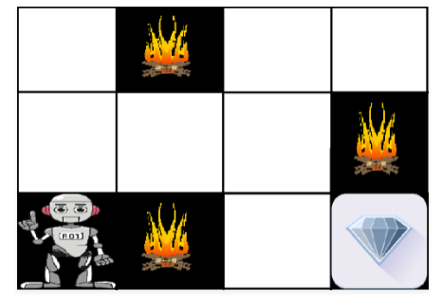
Types of Machine Learning (contd.)
Reinforcement learning: Reinforcement learning is a machine learning training method based on rewarding desired behaviors and/or punishing undesired ones. It helps an agent to maximize its cumulative reward. Example:
The above image shows the robot, diamond, and fires. The goal of the robot is to get the diamond and avoid the hurdles that are fires. The robot learns by trying all the possible paths and then choosing the path which gives him the diamond with the least hurdles. Each right step will give the robot a reward and each wrong step will subtract the reward of the robot. The total reward will be calculated when it reaches the final destination that is the diamond.

Slide 6
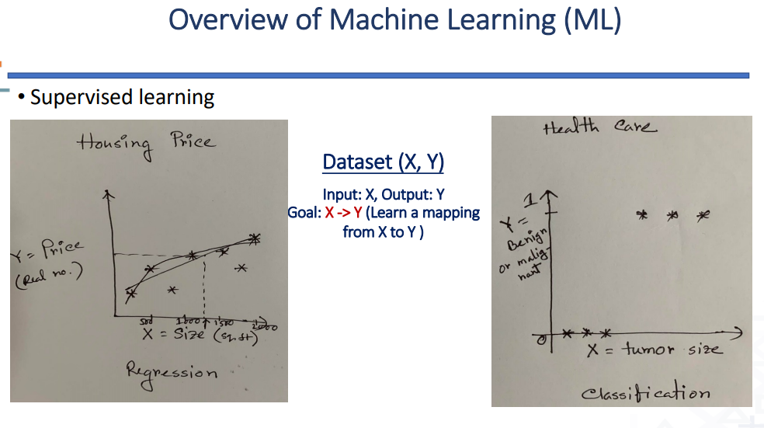

Slide 7
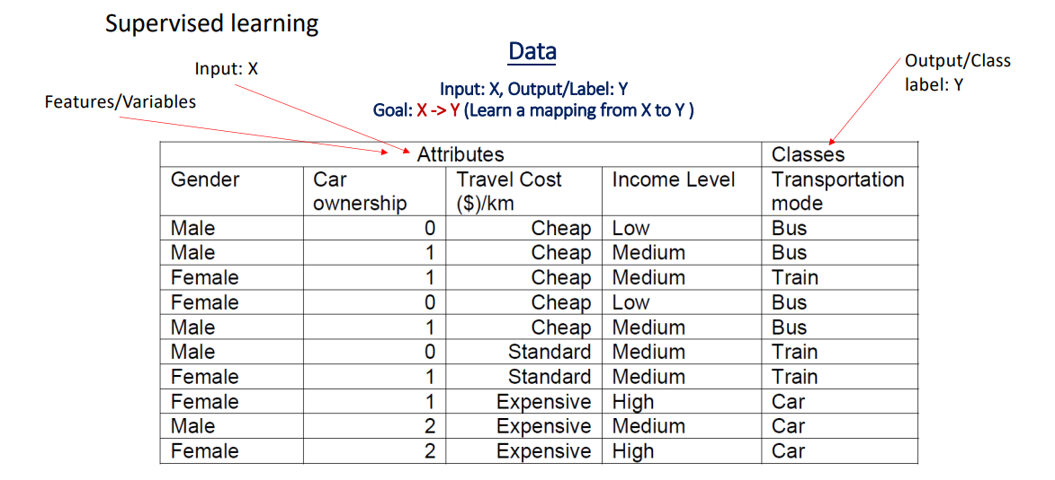

Slide 8
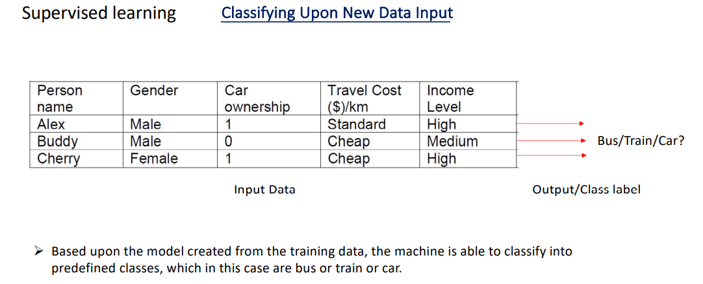

Slide 9
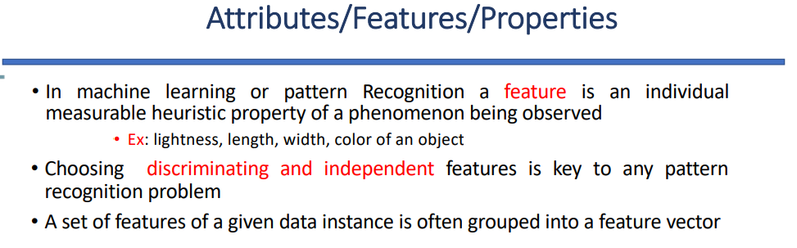

Slide 10
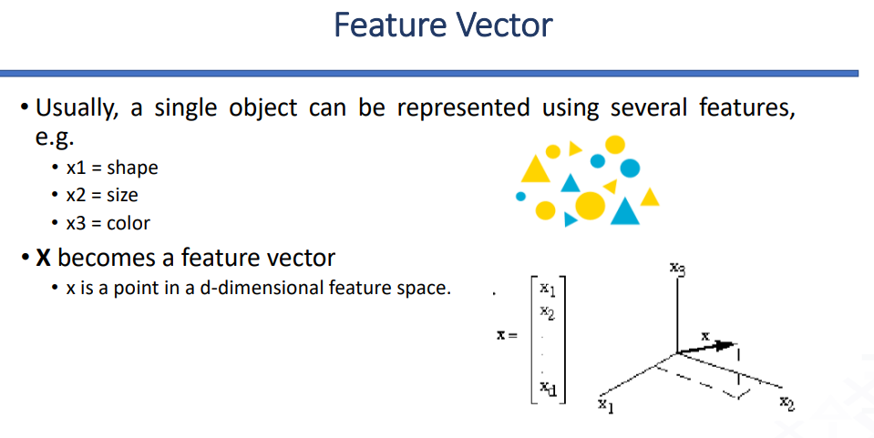
Feature Space: Data is represented as features (measurable properties).
A Feature Vector is a set of these features that represents an object as a single point in a multi-dimensional space.

Slide 11
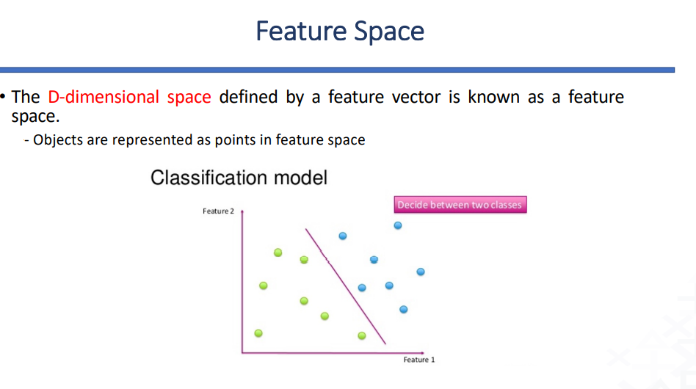

Slide 12
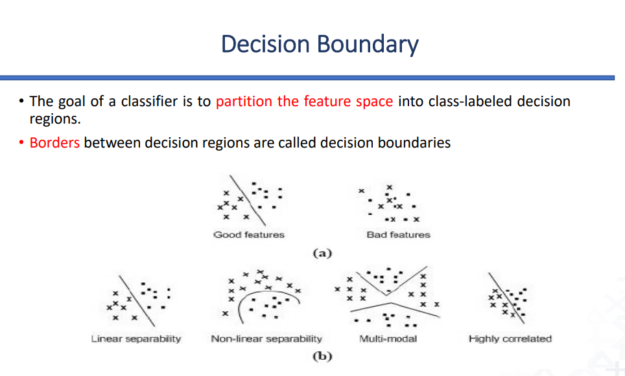
Decision Boundary: This is the line or surface that separates different classes in the feature space.

Slide 13
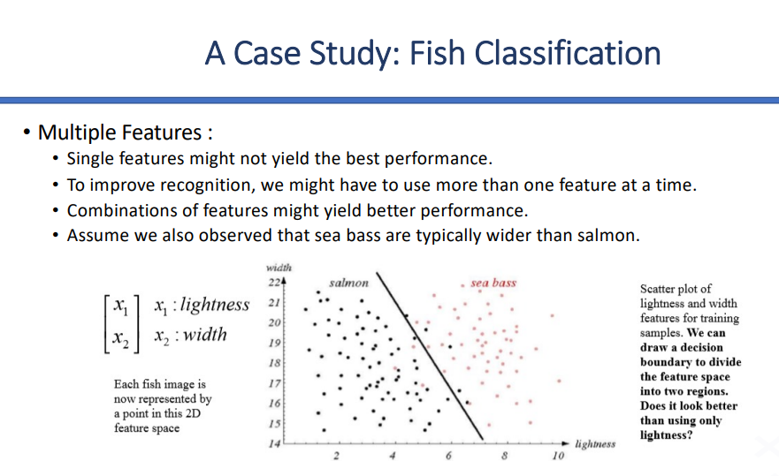


Slide 14
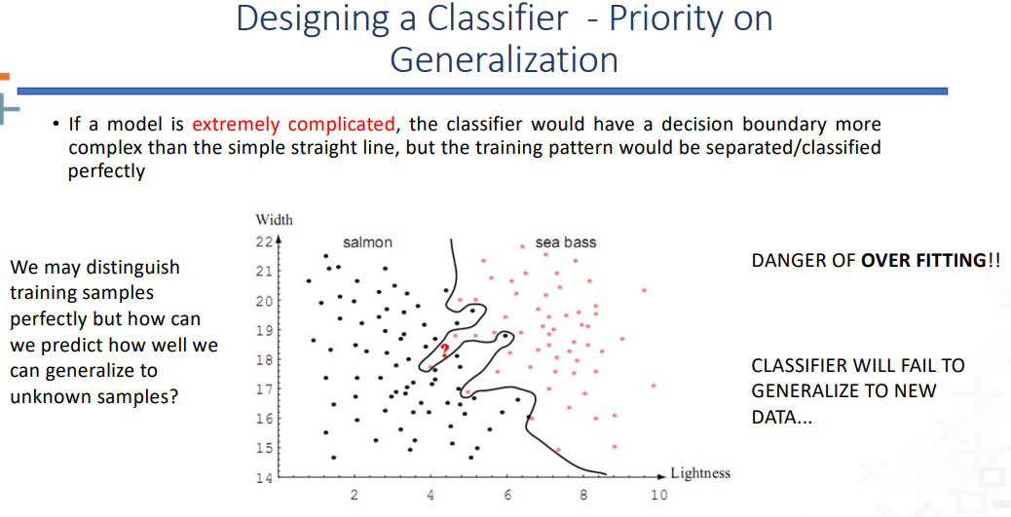

Slide 15
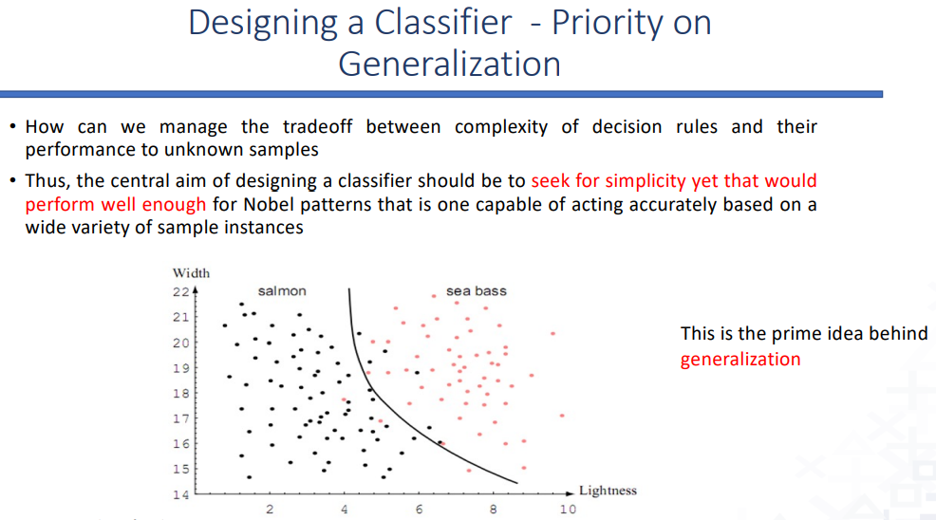

Slide 16
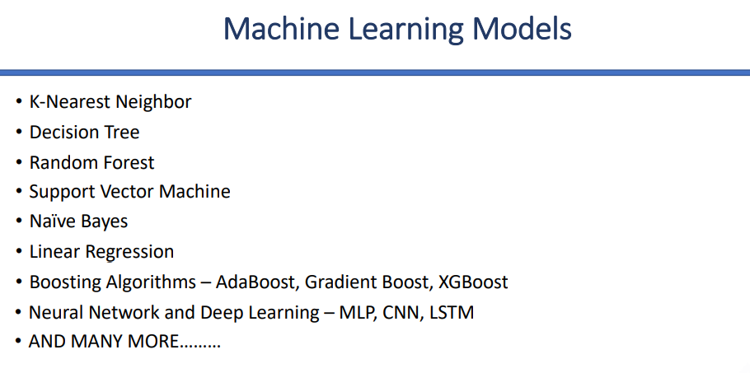

Slide 17
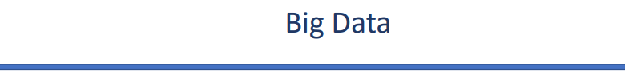
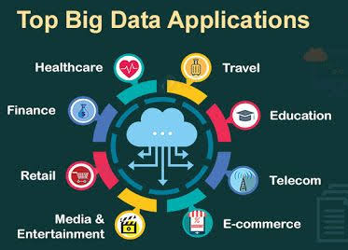
Big Data is a collection of data that is huge in volume, yet growing exponentially with time.

Slide 18
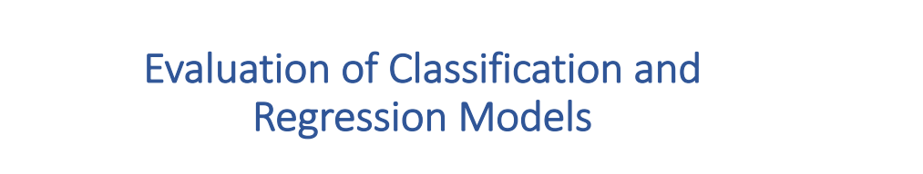

Slide 19
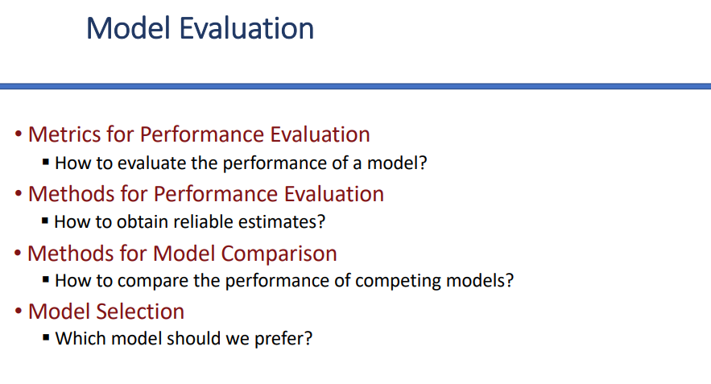

Slide 20
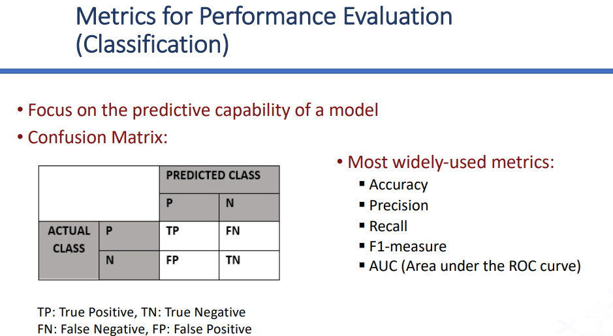

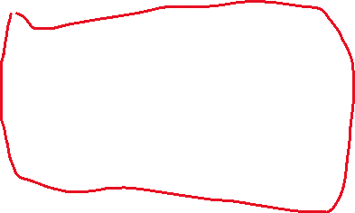




Evaluation Metrics
To know if a model is "good," we use specific calculations:
Accuracy: Total correct predictions divided by total predictions.
Precision: Out of all the positive predictions the model made, how many were actually correct? (Focuses on avoiding False Positives).
Recall: Out of all the actual positive cases that exist, how many did the model find? (Focuses on avoiding False Negatives).
F1-Score: The harmonic mean of Precision and Recall; it provides a single score that balances both.

Slide 21
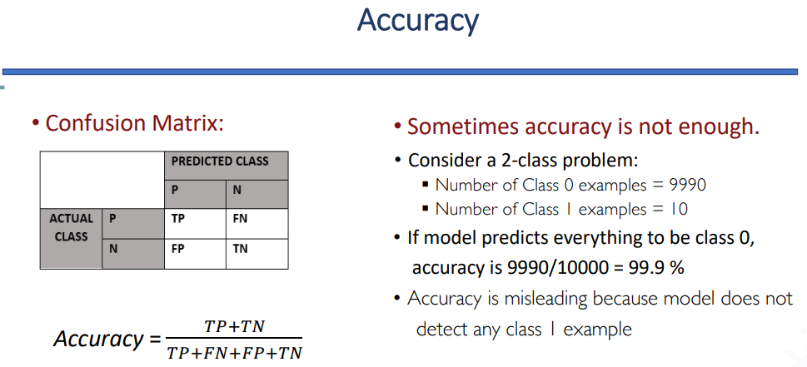
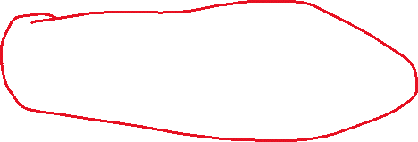

Slide 22



Precision: Out of all the positive predictions the model made, how many were actually correct? (Focuses on avoiding False Positives).
Recall: Out of all the actual positive cases that exist, how many did the model find? (Focuses on avoiding False Negatives).

Slide 23
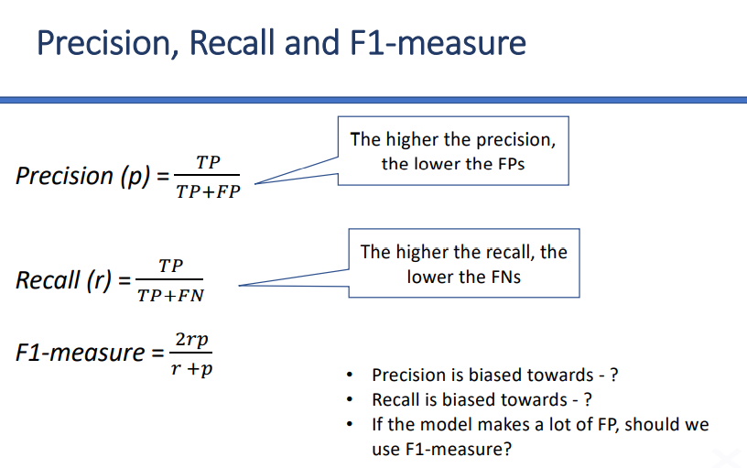


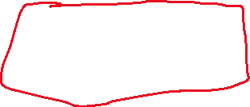



Slide 24



Precision is biased toward false positives (FP).
High precision = very few false positives.
If your model predicts “positive,” you can trust it more.
Example: In spam detection → high precision means very few legitimate emails are wrongly flagged as spam.
Recall is biased toward false negatives (FN).
High recall = very few false negatives.
If something is positive, the model rarely misses it.
Example: In disease detection → high recall means you catch most sick patients, even if you sometimes wrongly classify healthy people.
If the model makes a lot of false positives, using F1-score can be useful in evaluating its performance. F1-score combines both precision and recall into a single metric, providing a balanced measure of the model's accuracy that accounts for both false positives and false negatives.

Slide 25
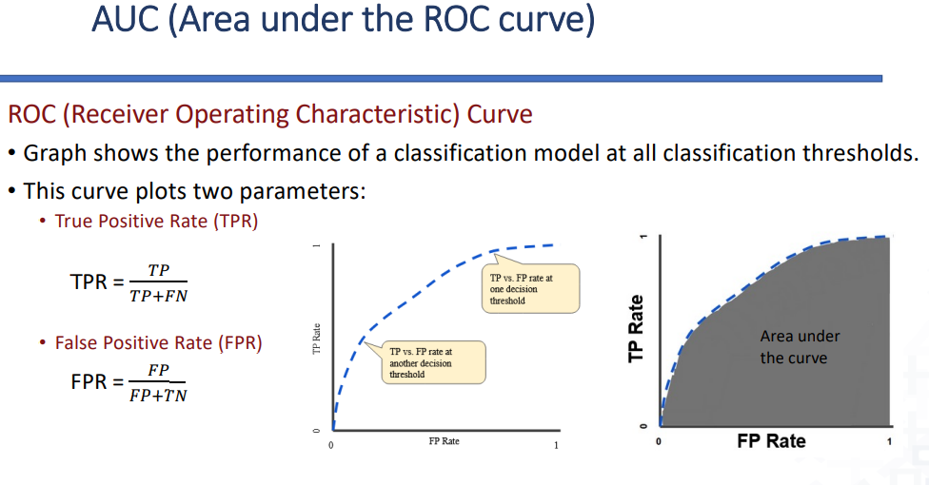



Slide 26
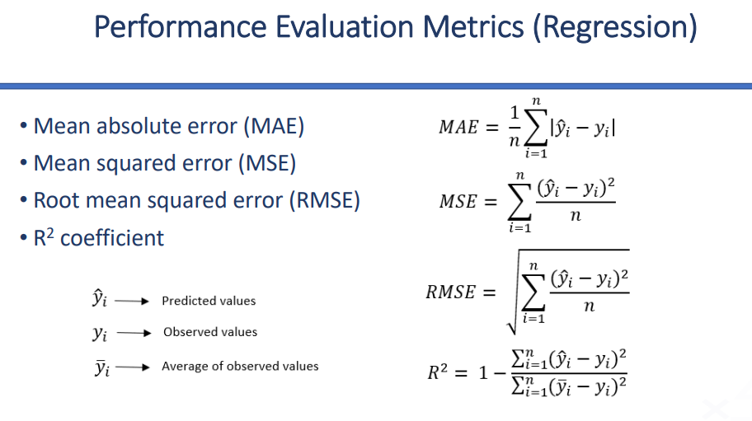


Slide 27
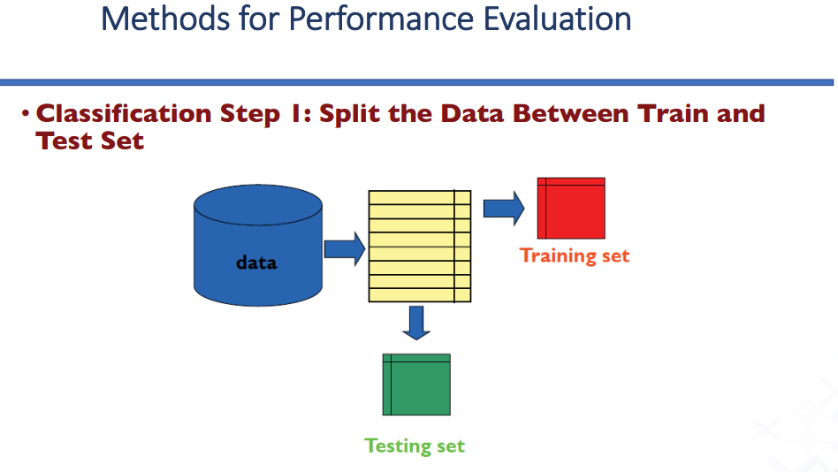

Slide 28
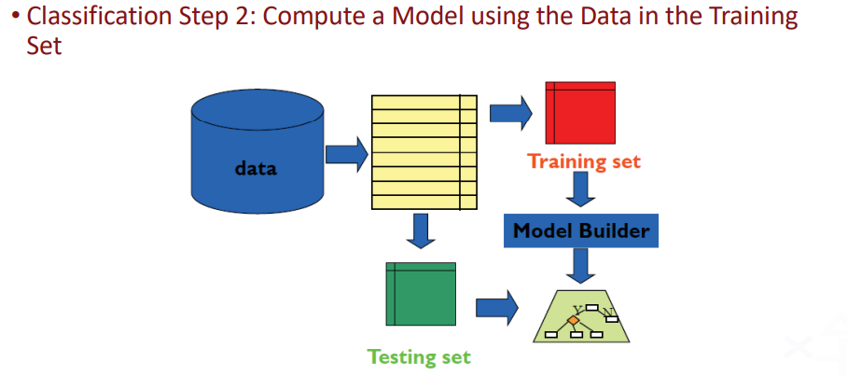

Slide 29
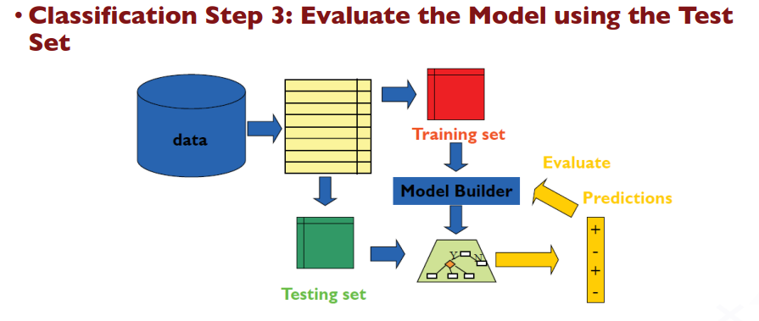

Slide 30

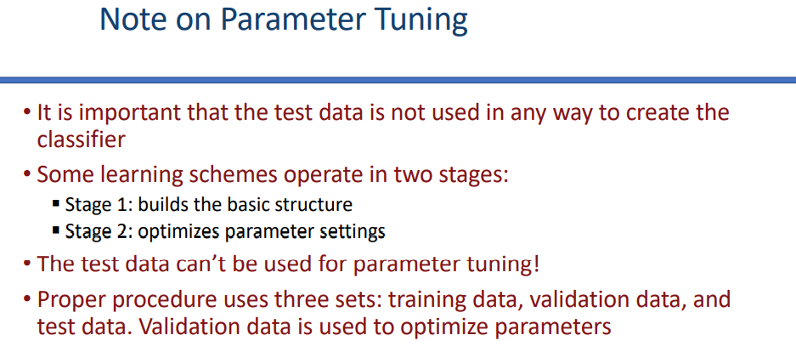

Slide 31
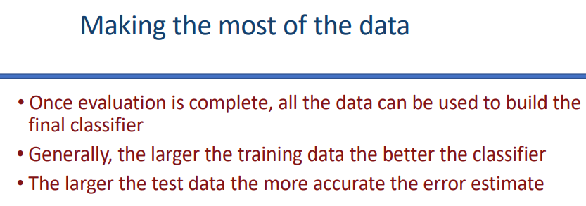

Slide 32
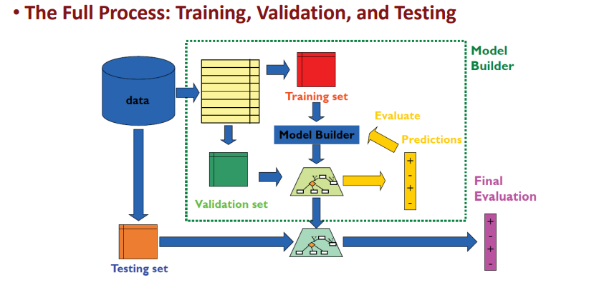

Slide 33
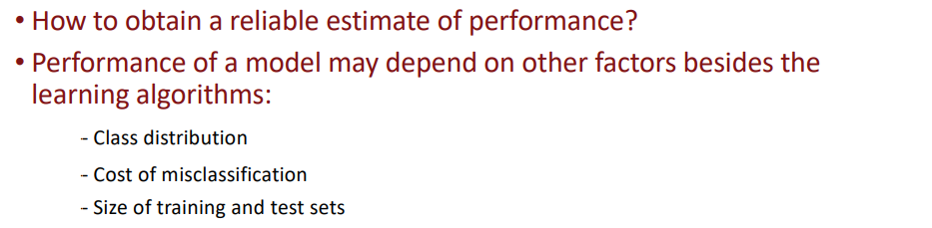

Slide 34
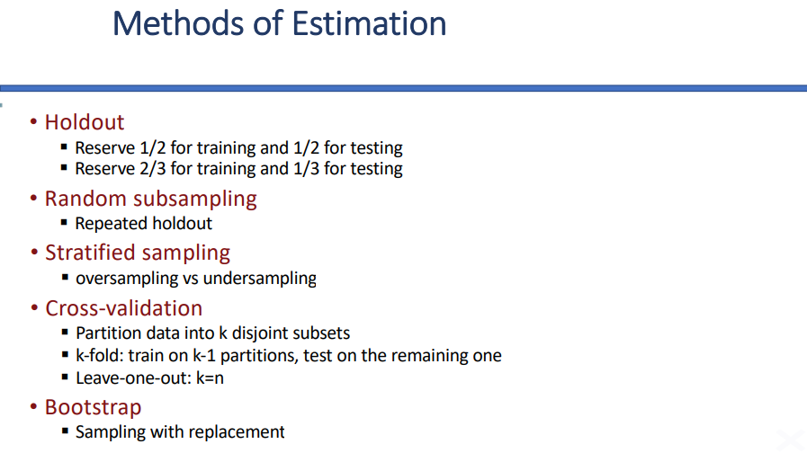

Slide 35
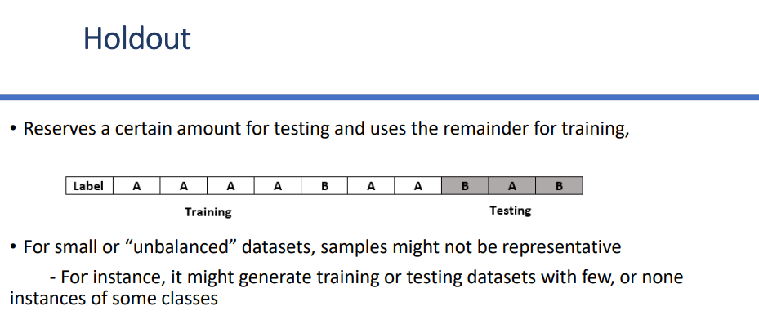

Slide 36
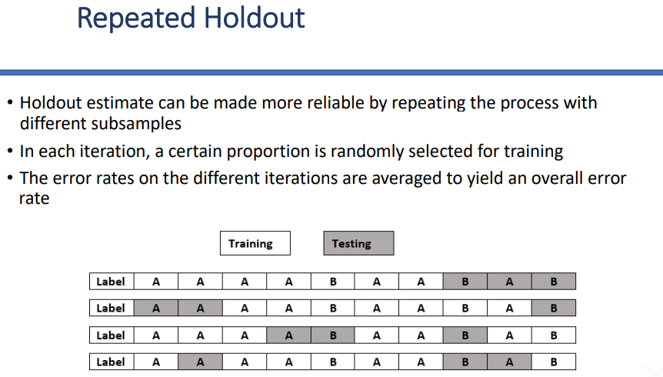

Slide 37
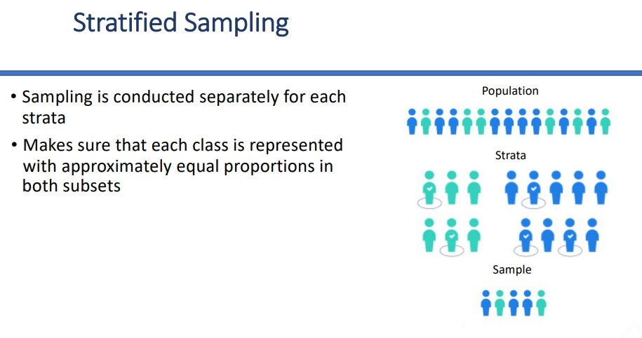

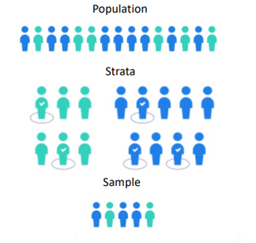
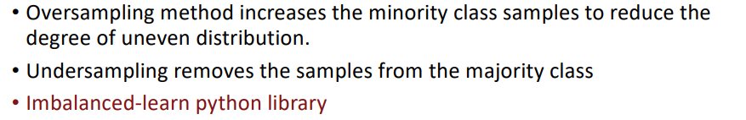

Slide 38
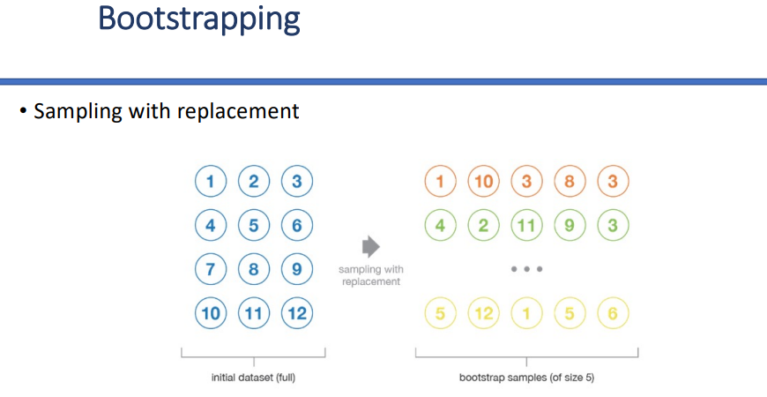

Slide 39
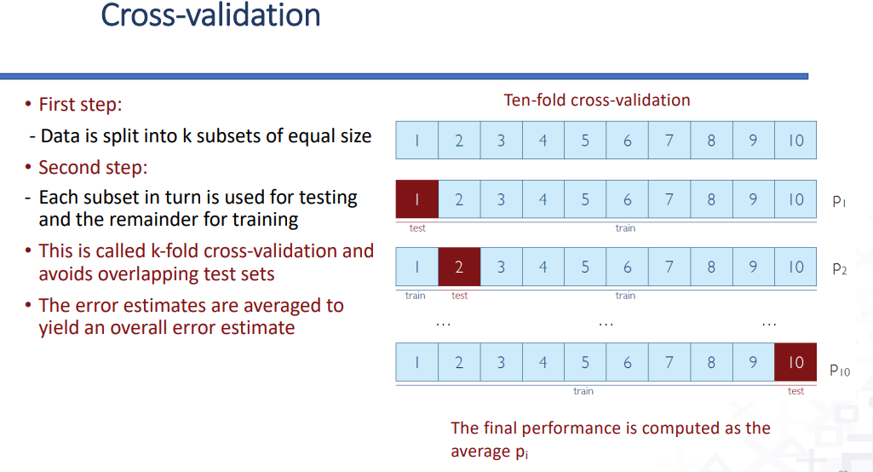

Slide 40
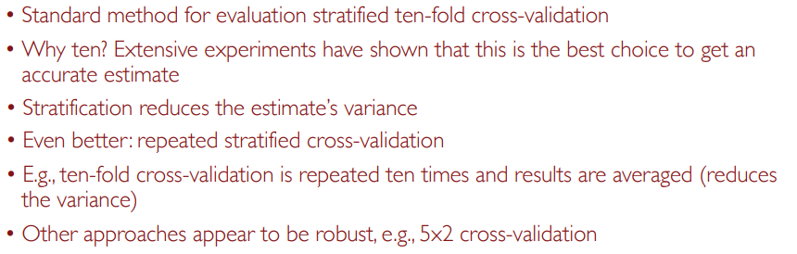


Slide 41
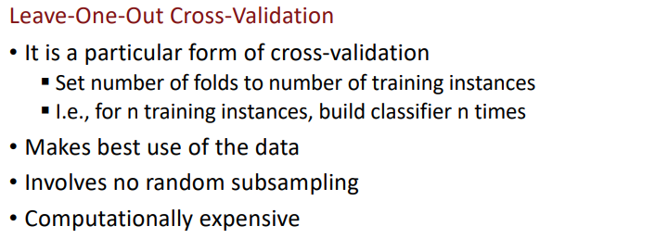

Slide 42
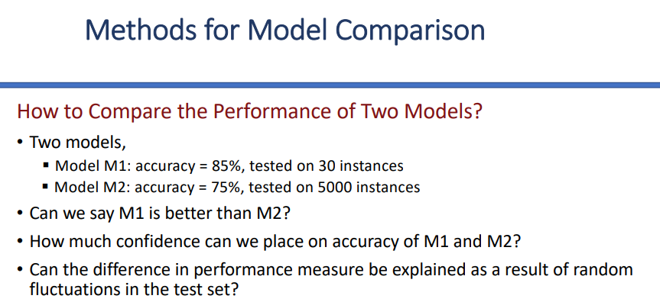



Slide 43

Typical approach:
Use 10-fold cross-validation to get stable performance estimates for each model.
Then, apply a Student’s t-test to check if the difference in their performances is statistically significant.
Bottom Line
M1 looks better (85% vs. 75%), but since it’s tested on only 30 cases, we cannot trust it yet.
We should use cross-validation + statistical significance test (t-test) to decide which model is actually better.

Slide 44
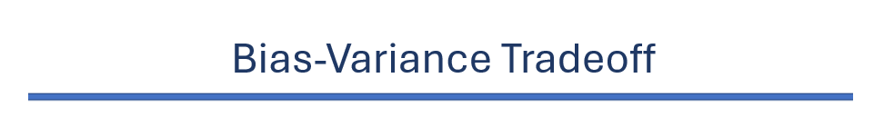


Generalization, Overfitting, and Underfitting
Generalization: The model's ability to perform well on new, unseen data.
Overfitting: The model is too complex and learns the "noise" in the training data. It performs perfectly on training data but fails on new data (High Variance).
Underfitting: The model is too simple and fails to find the pattern even in the training data (High Bias).
The Tradeoff: The goal is to find the "sweet spot" where both Bias and Variance are low.
Bias: The amount by which the expected model prediction differs from the true value of the target OR how far our predictions from real values.
High bias → model is too simple, underfits (misses important patterns).
Variance: Variance is the variation in the predicted value across different datasets.
High variance → model is too complex, overfits (captures noise).
Bias–Variance Tradeoff: We want a balance- not too simple (high bias), not too complex (high variance).
Underfitting means that the model is too simple and does not cover all real patterns in the data.
Overfitting means that the model learns not just the underlying pattern, but also noise or random quirks in the training data. model memorizes training data

Slide 45
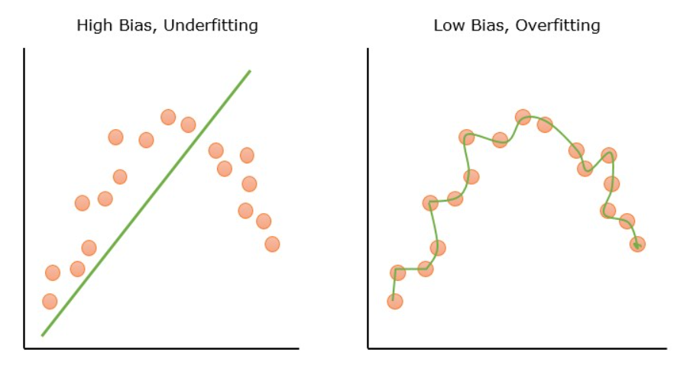

Slide 46
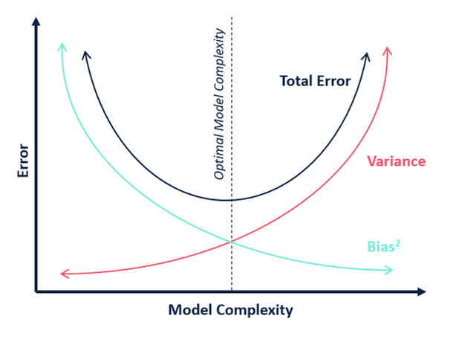

Slide 47
From Ai:
Practice Questions & Answers
Q1: What is the main difference between Classification and Regression? A: Classification predicts a discrete label or category (like "Red" or "Blue"), while Regression predicts a continuous numerical value (like "75.5").
Q2: If a model has 100% accuracy on training data but only 50% accuracy on test data, what is happening? A: The model is Overfitting. It has memorized the training data specifically but cannot generalize to new, unseen information.
Q3: When should you use the F1-Score instead of Accuracy? A: You should use the F1-Score when you have an imbalanced dataset (e.g., a medical test where 99% of people are healthy and only 1% are sick) or when you need a balance between Precision and Recall.
Q4: Explain the purpose of "10-fold Cross-Validation." A: It is a technique used to get a stable estimate of a model's performance. The data is split into 10 parts; the model is trained on 9 and tested on 1. This repeats 10 times so every piece of data is used for testing once.
Q5: Define "Bias" and "Variance" in the context of ML. A: Bias is the error caused by a model being too simple (leading to underfitting). Variance is the error caused by a model being too sensitive to small fluctuations in the training set (leading to overfitting).
Gemini te qstn ach brief gula

